Slide 1
Course Project
Operating Systems
Intro to Linux
May24
By: Jonathen Weidman

Slide 2
Introduction
In this course, I was given the opportunity to explore the Linux OS and learn how to navigate it.
I was able to execute a large amount of system administrative tasks using a virtual machine.
Each week I learned a different aspect of running commands in the terminal on a single computer and on a network of computers.
I started with the basics of the directory tree with adding directories and files as well as removing them. I was also able to change user and group permissions on directories and files.
I also learned how to add and remove users and modify new user permissions. In this course, I was taught how to check the network and IP information of the system.
There was so much I learned and picked up on quick I was excited each week to learn more.

Slide 3
Module 2 Overview
Activity
Navigate the Linux filesystem tree
Create directories and files
Copy and remove directories and files
Locate directories and files

Slide 4
Navigate the Linux filesystem tree
1. What is the pwd command an acronym for? What about the cd command?
Answer here: Print Working Directory and it tells you the absolute pathname of the directory your currently in. the cd command stands for ‘change directory’. It will allow you to change which directory you are currently accessing.
2. Explain the differences between a relative path and an absolute/full path in Linux.
Answer here: A relative path is a file or subdirectory inside of a directory such as in the Documents directory ”test.txt” but absolute path would be “/Documents/test.txt”
References:
1. Linux+ and LPIC-1: Guide to Linux Certification
2. https://en.wikipedia.org/wiki/Pwd#:~:text=In%20Unix%2Dlike%20and%20some,directory%20to%20the%20standard%20output.

Slide 5
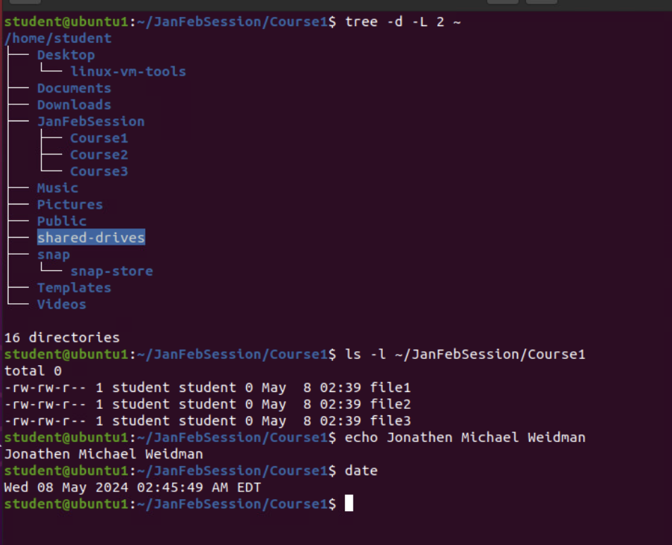
Create directories and files
In this portion of the first project, I did on the Linux virtual machine, I created the ‘JanFebSessions’ directory as well as the three course directories. I created three files to the directory. I also viewed the files shown in the ‘Course1’ directory while viewing the permissions.

Slide 6
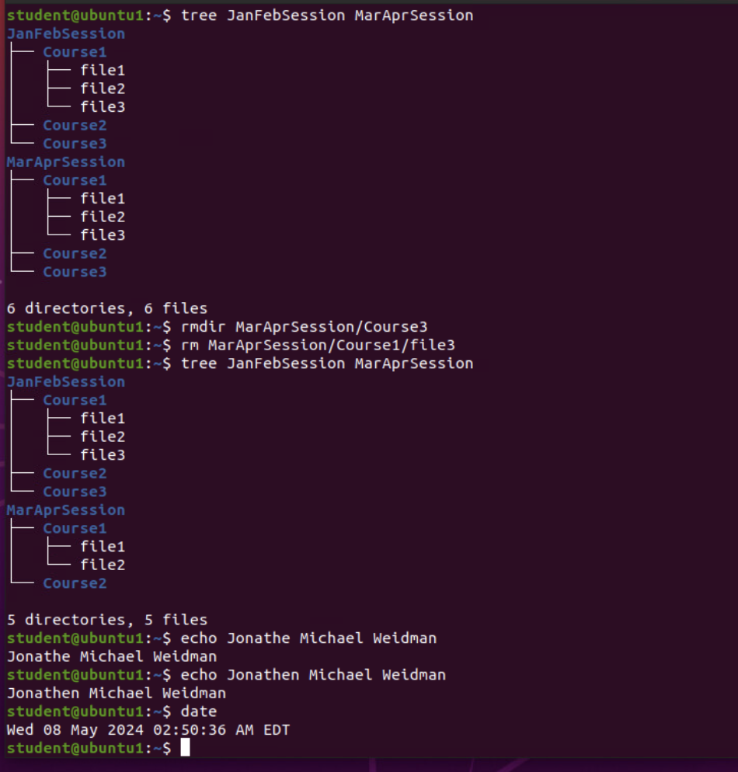
Copy and remove directories and files
In this section, I copied the “Course” directories from the ”JanFebSession” directory to the ”MarAprSession” directory. I then removed the ”Course3” directory from the “MarAprSession” as well as the “Course1/file3”. I then viewed what remained in the directory tree of the two directories that I created.

Slide 7
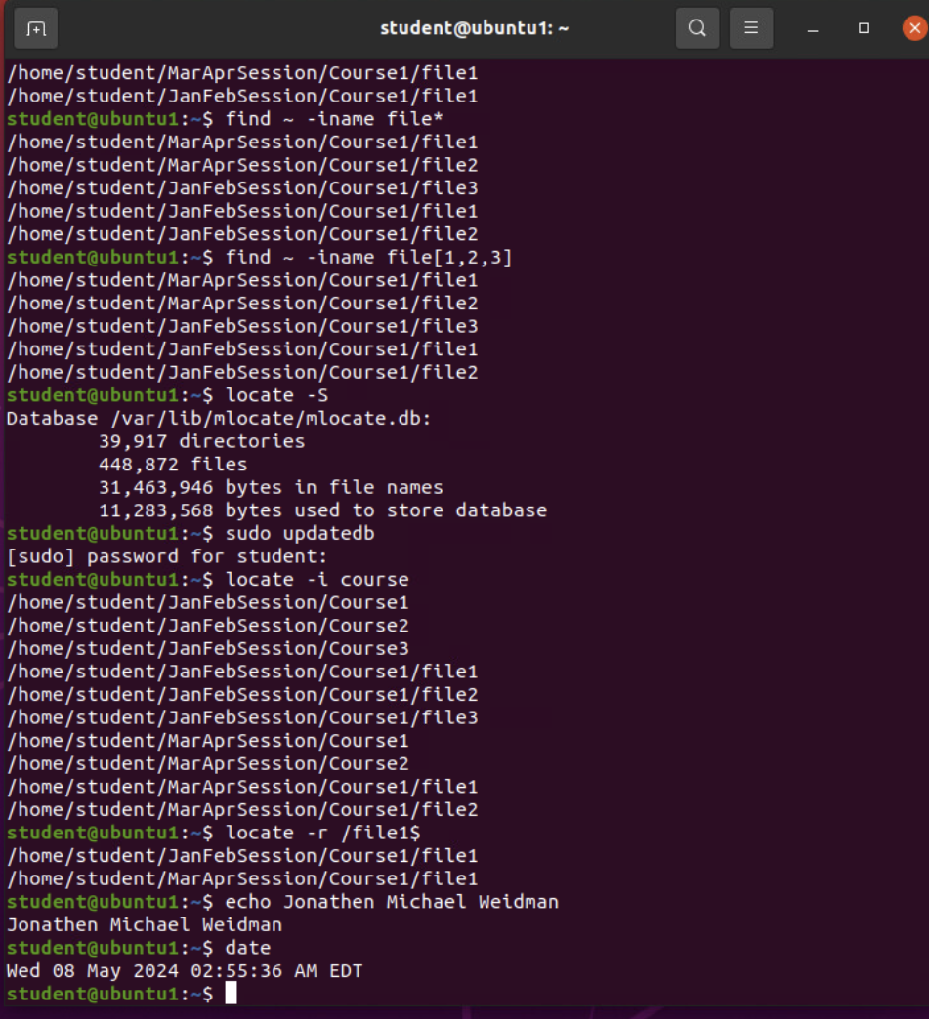
Locate directories and files
In this part, I demonstrated locating directories and files using the “find” command and the “locate” command. In the first couple of examples, I show how to find the files containing “file” in the name under the home directory. I then updated the database using “updated” to get a more accurate search of directories from the ”locate” command.

Slide 8
Module 3 Overview
Activity
Create a shell script
Change script file permissions
Set the PATH variable
Make the PATH variable permanent

Slide 9
Create a shell script
1. What are the file permissions of the script?
Answer here: The file permissions are –rw-rw-r– (User: read and write, Group: read and write, Other: read)
2. What’s the name of the user-defined variable in the script?
Answer here: The user-defined variable in the script is $text
3. Which redirection meta-character is used in the script? What does it do?
Answer here: The redirection meta-character is the > meta-character that takes the output of the commands used and saves them in the file MyToDoList.
References:
1. Linux+ an LPIC-1 Guide to Linux Certification

Slide 10
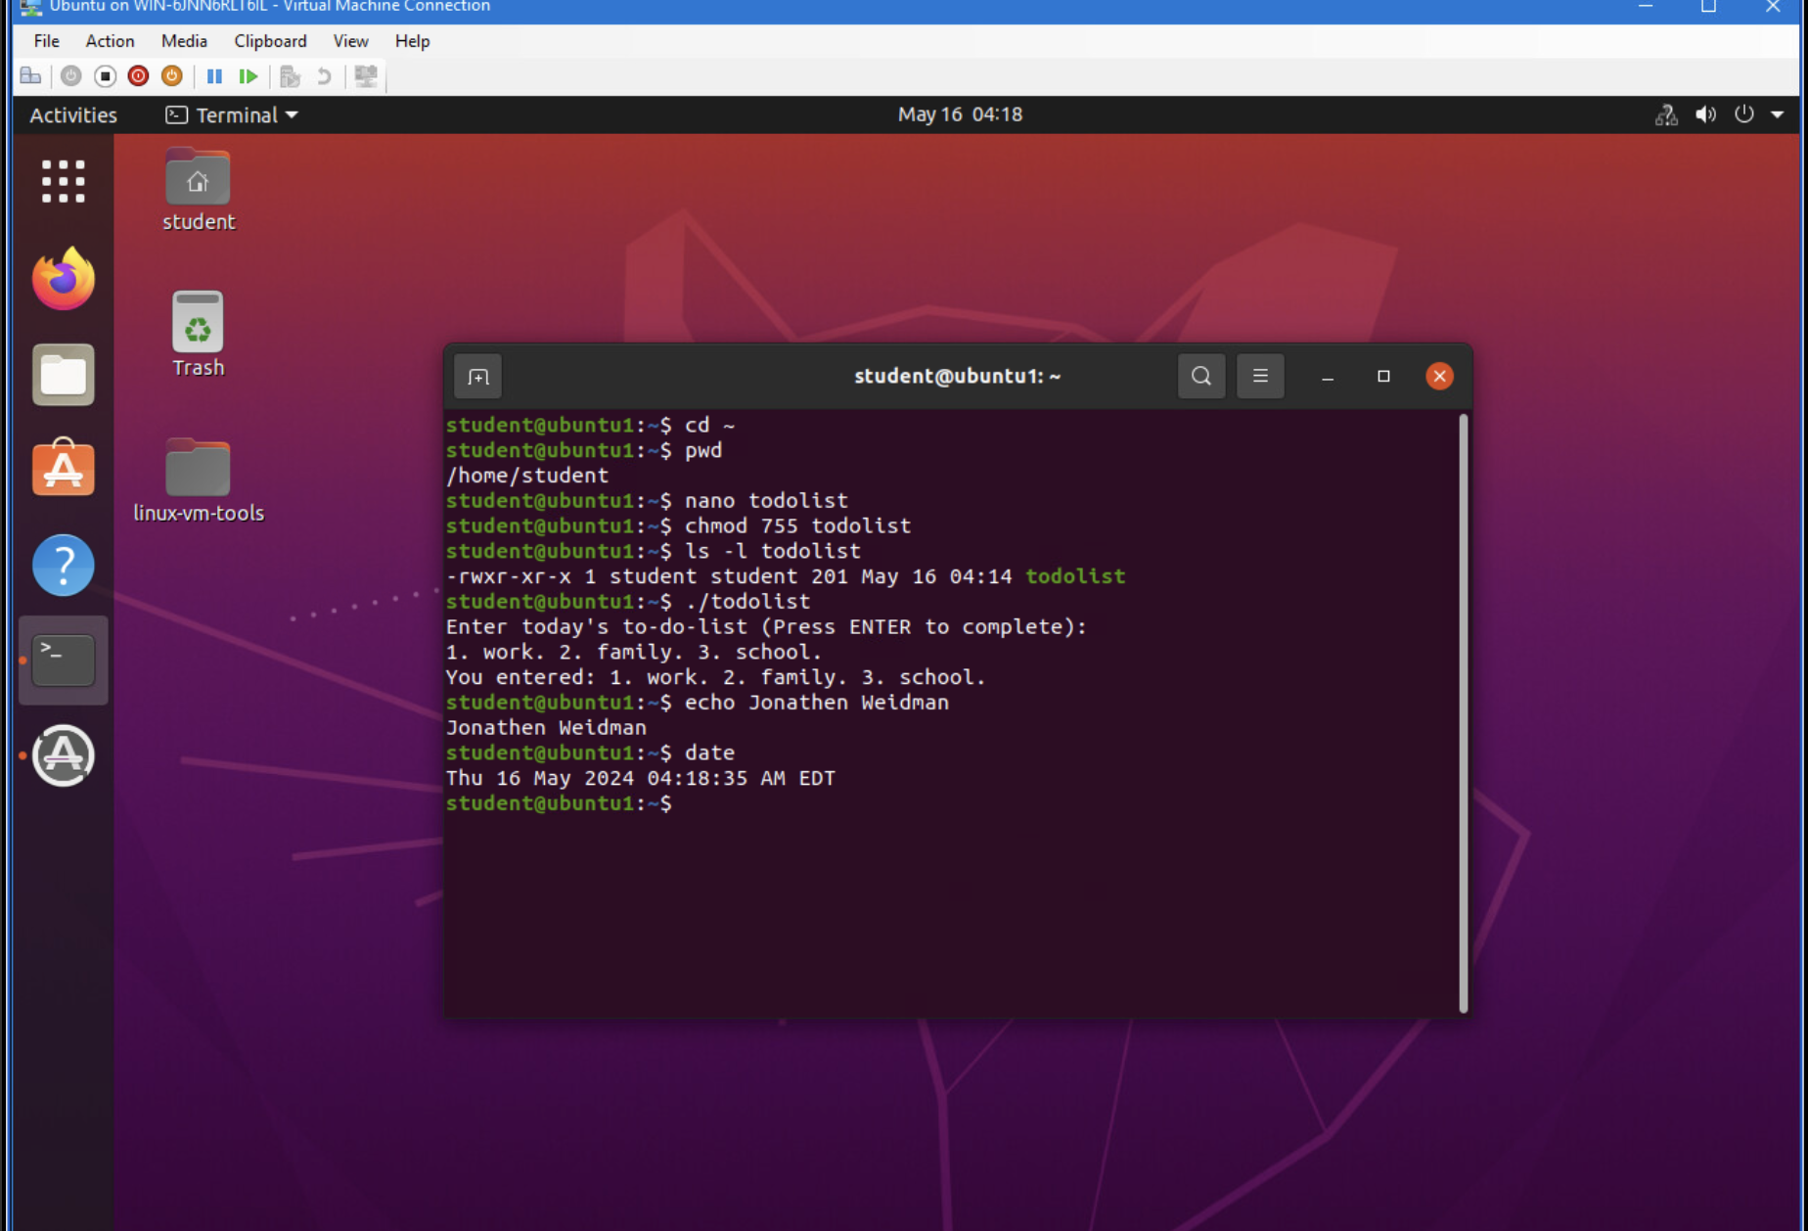
Change script file permissions
Here, I am changing the permissions for user, group, and other using the ”chmod” command with the 777 format. As you see, I was able to change the permissions on the “todolist” to allow the user to read, write, and execute (rwx), the group to read, and execute (r-x), and others to read, and execute (r-x). All together it came out as “rwxr-xr-x”.

Slide 11
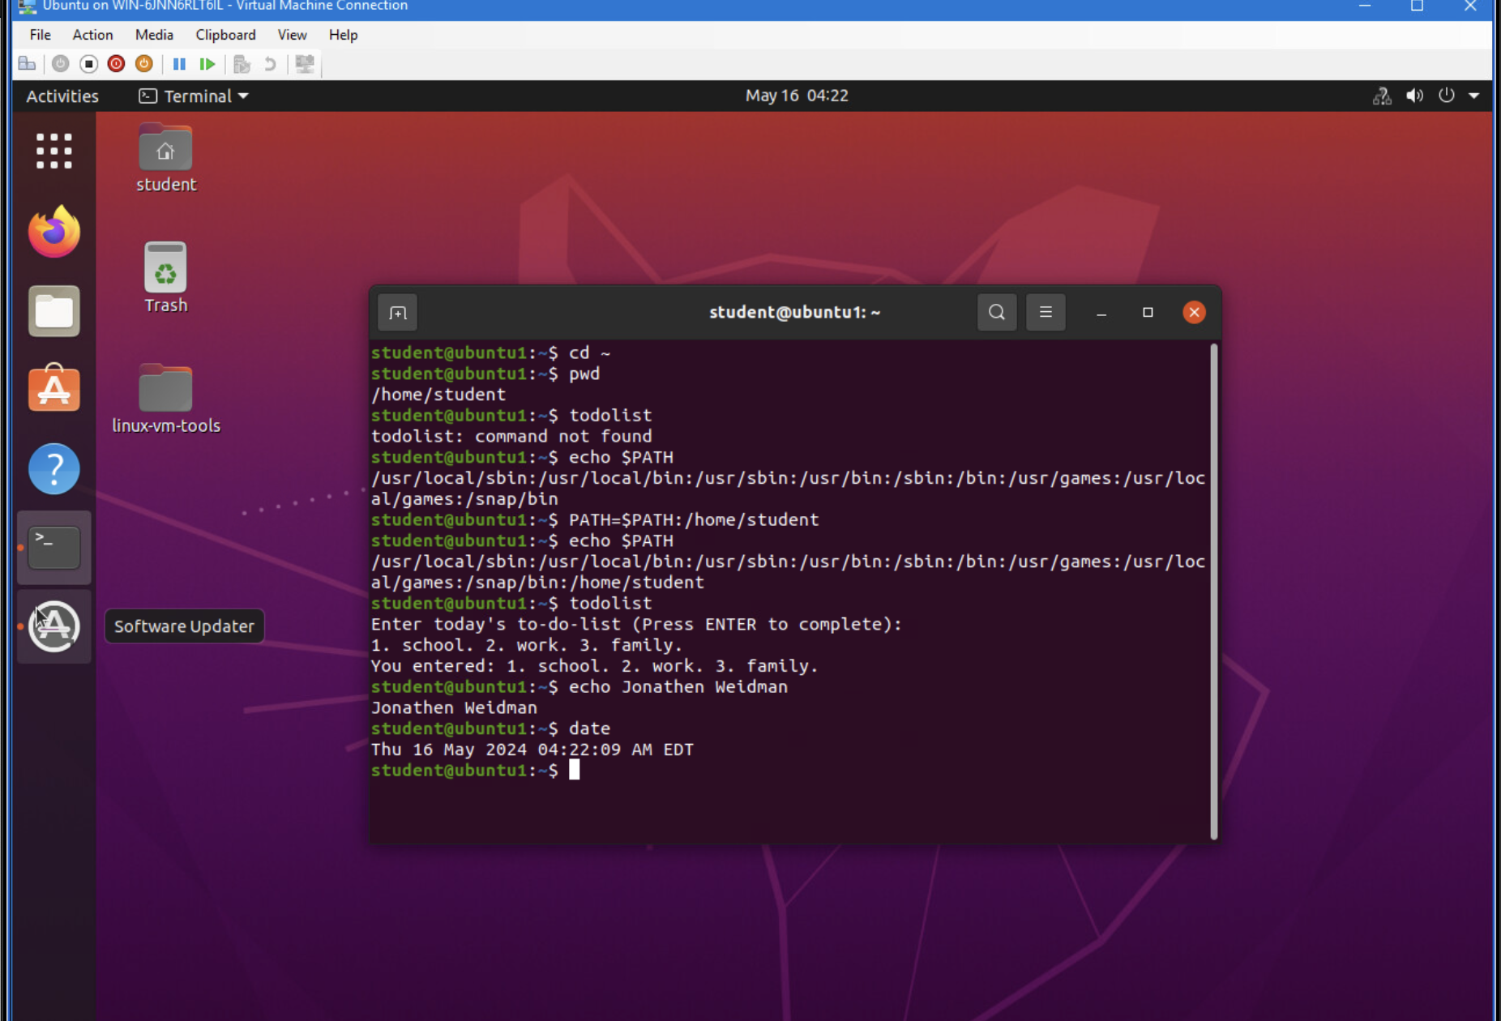
Set the PATH variable
This screenshot shows me setting the PATH variable for /home/student allowing me to use the “todolist” command and enter the input.

Slide 12
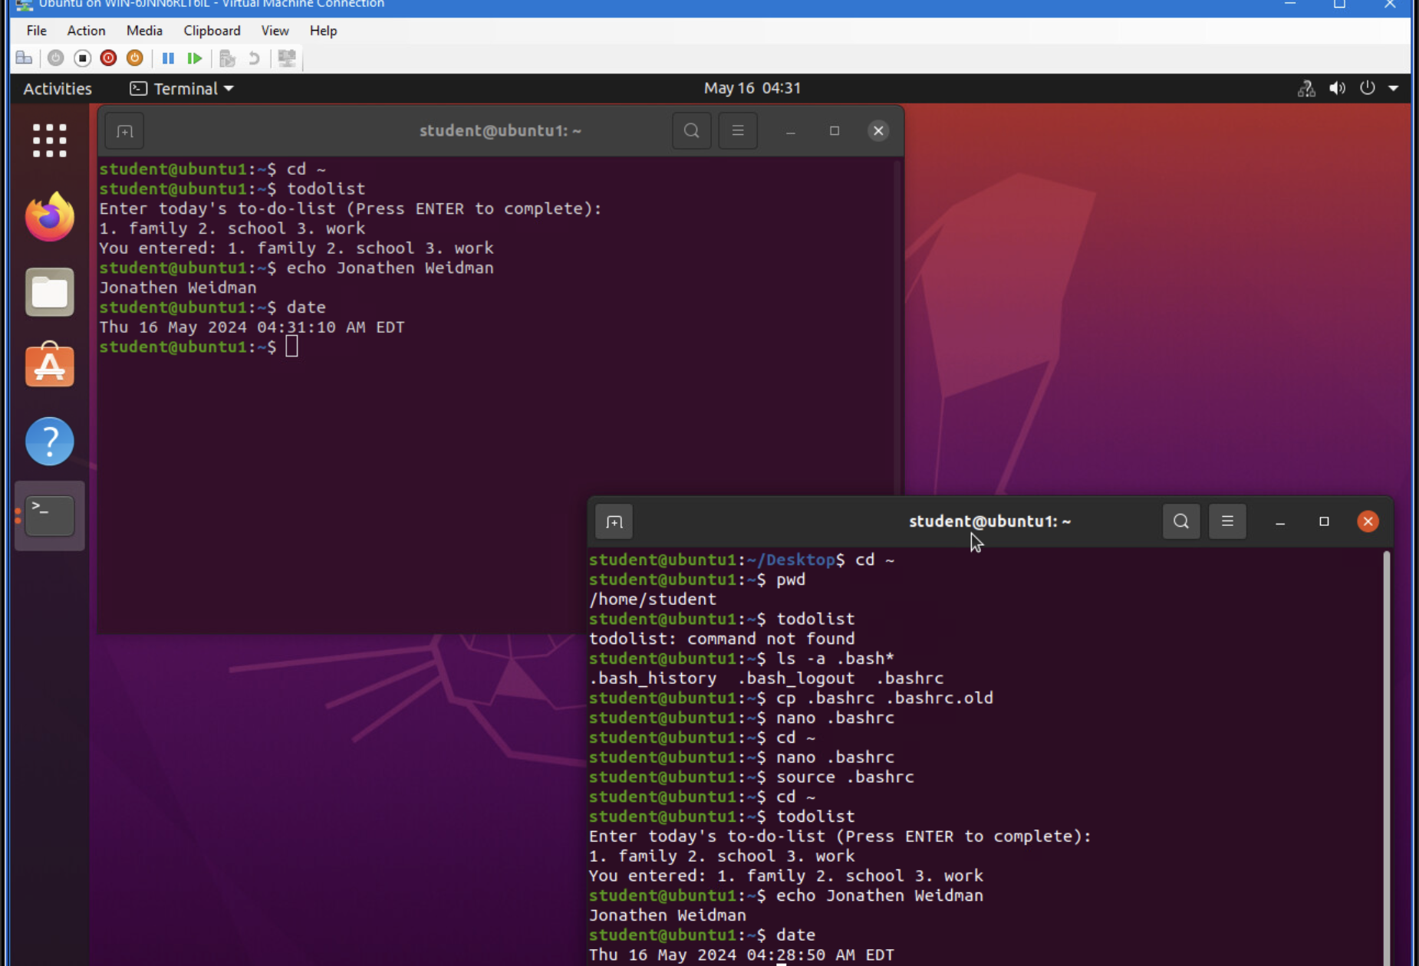
Make the PATH variable permanent
Here, I am using the “todolist” script before and after making the PATH variable permanent. In the lower terminal you can see the before and the upper terminal shows the after.

Slide 13
Module 4 Overview
Activity
Add users and groups in CLI
Test user and group settings
Add users in GUI
Remove users and groups

Slide 14
Add users and groups in CLI
1. What does the –m option in the useradd command do?
Answer here: It creates the new users home directory.
2. What does the -3 option in the tail command do?
Answer here: Shows the last 3 lines of the file instead of the last 10 lines.
3. Which line of the /etc/group file lists members of the “students” group? Copy it here.
Answer here: students:x:1002:student,mary
References:
1. Module 4 Lesson 2

Slide 15
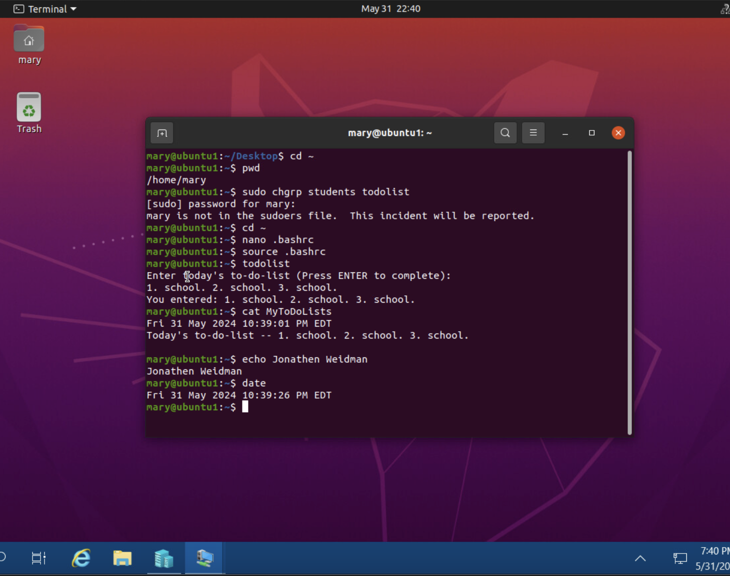
Test user and group settings
In this example, I demonstrate how I would go about testing a new user that I added to the virtual machine using the terminal. I also show how to change the group settings for the user that is currently logged in to be able to utilize the “todolist” script

Slide 16
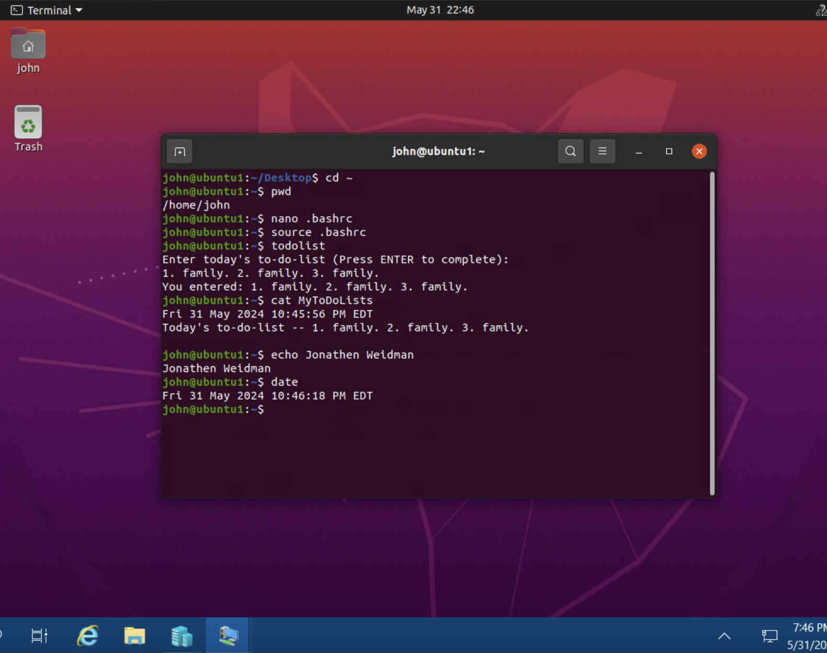
Add users in GUI
This slide shows the new user that I was able to add in the GUI. I also edited the group permission for this user in the GUI allowing him to access the ”todolist” script.

Slide 17
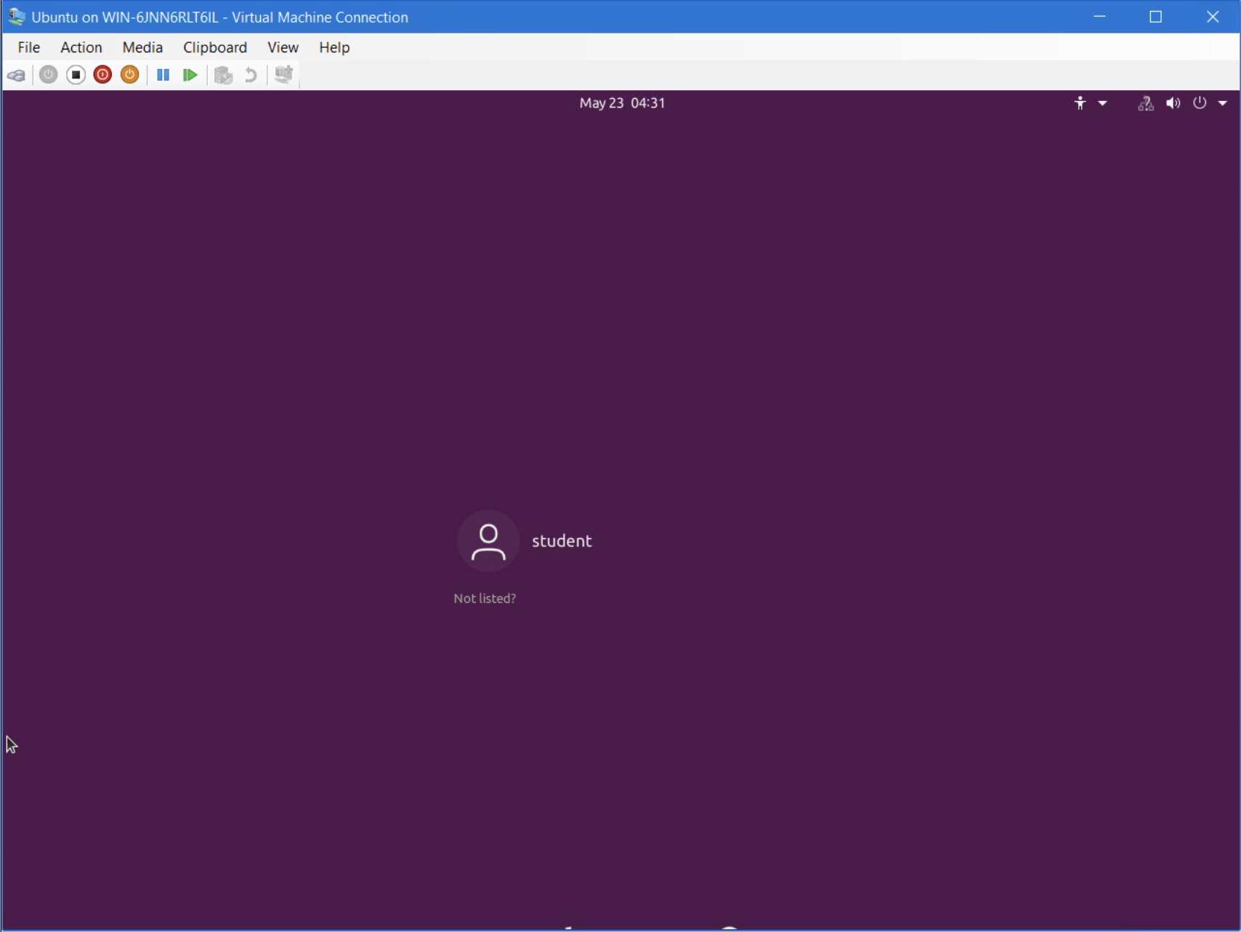
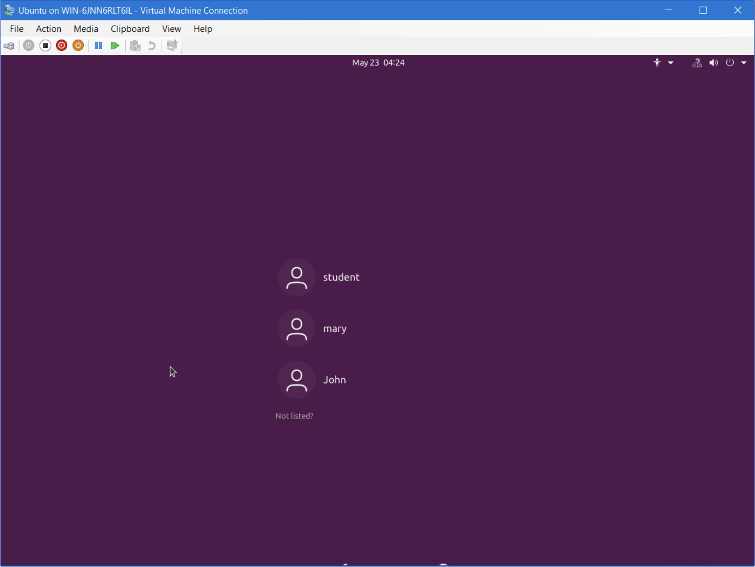

Remove users and groups
In these screenshots I show the before and after results of removing the users from the previous slides.

Slide 18
Module 5 Overview
Activity
Discover host IP configurations
Manage network interfaces
User network utilities

Slide 19
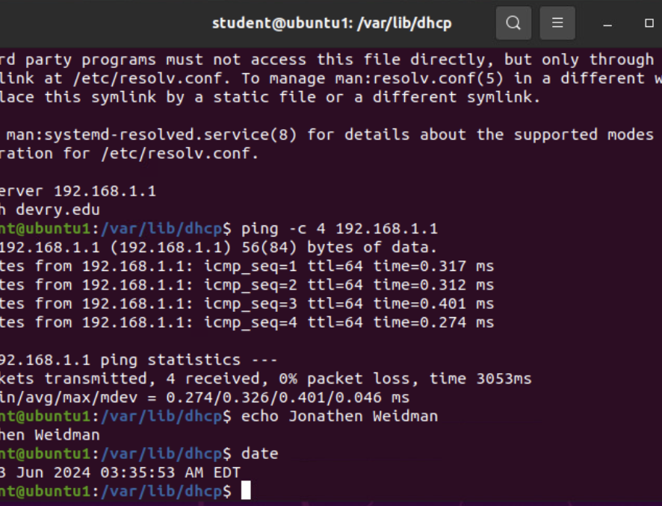
Discover host IP configurations
Take a screen capture of the output in Step 12.
1. What is the IP address of your Ubuntu machine?
Answer here: 192.168.1.107
2. What is the IP address of its default gateway?
Answer here: 192.168.1.0
3. What is the IP address of its DHCP server?
Answer here: 192.168.1.1
4. What is the IP address of its DNS server?
Answer here: 192.168.1.1

Slide 20
Manage network interfaces
Which DHCP message is shown in the output of the sudo dhclient –v –r eth0 command?
Answer here:
DHCPRELEASE
2. Which four DHCP messages are shown in the output of the sudo dhclient –v eth0 command?
Answer here:
DHCPDISCOVER
DHCPOFFER
DHCPREQUEST
DHCPACK

Slide 21
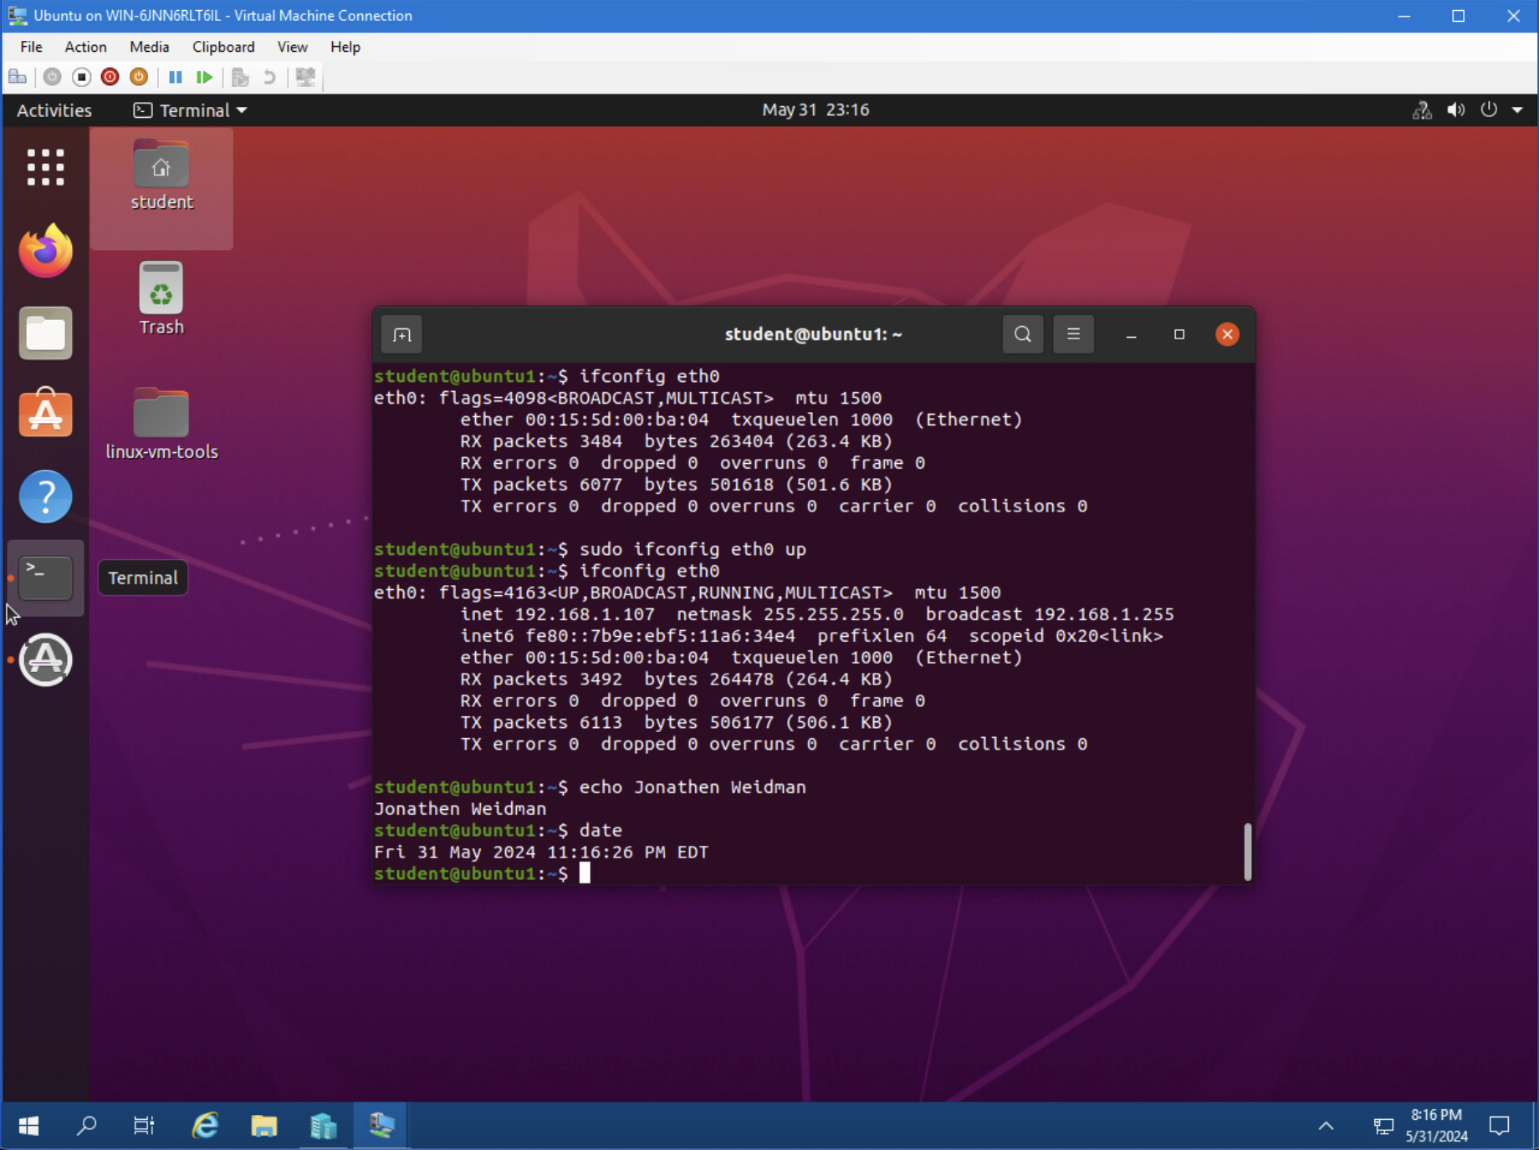
Use network utilities
In this section, I show how to utilize the network utilities and using the “ifconfig” command.

Slide 22
Module 6 Overview
Activity
Monitor processes
Monitor user activities
Monitor network bandwidth usage

Slide 23
Monitor Linux processes
1. What is the default action of the 15 SIGTERM kill signal?
Answer here: It will request to close the selected program.
2. In the System Monitor window, click on % CPU to sort the processes by CPU load. Which process shows the highest percentage of CPU usage?
Answer here: gnome shell has the highest cpu usage
References:
1. Infosec VM

Slide 24
Monitor user activities
Issue the sudo accton on command to turn on GNC accounting. Run the sudo updatedb command. Enter lastcomm updatedb to check if the updatedb command was executed before. Remember to turn off GNC accounting (sudo accton off) after answering the questions.
1. What flag value is displayed in the output?
Answer here: S
2. Why is the name of the user who ran the processes shown as root, not student?
Answer here: it was shown as root because we used the sudo command as the root user is the only user that can run those commands.
References:
1. Infosec VM

Slide 25
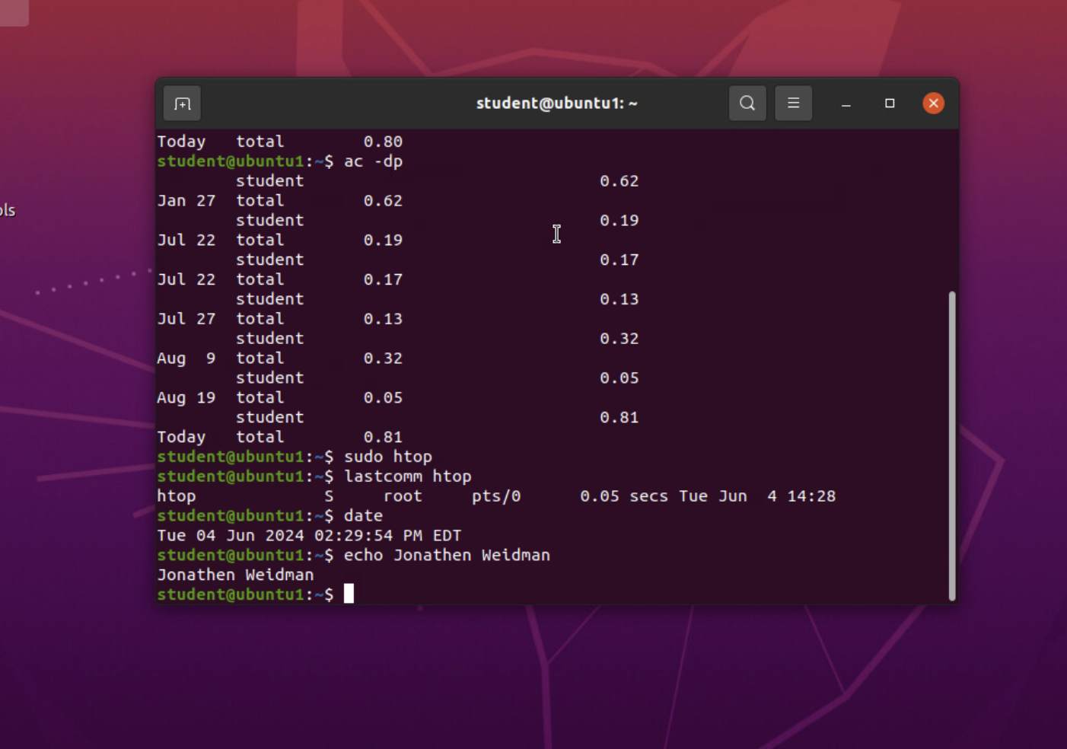
Monitor network bandwidth usage
Here I am demonstrating the network bandwidth usage using the “ac –dp” command. I also utilize the “lastcomm” to display the list of commands that I used last searching specifically for the “htop” command I used just before.

Slide 26
Challenges
In this course I faced a lot of challenges that I was able to quickly remedy with the strong support of my peers.
At first, I was unable to figure out how the virtual machines worked or how to even find them.
I couldn’t figure out how to get it all running properly with the DHCP server then the Ubuntu VM.
I was also challenged with the inability to read the outputs from the terminals whenever I put commands in that provided a long output.
Other than all of that, I was able to pick up on the rest rather quick.

Slide 27
Career Skills
I learned how to properly operate the Linux OS.
Also, this course taught me to control the basic aspects of a network. I learned how to utilize cloud computing.
In my time learning, I was able to secure the network on a VM and computers alone.
We learned how to add and remove users, groups, files, directories, and more.
I was taught to operate on a companies' network.

Slide 28
Conclusion
Thank you for taking the time to look over everything I have learned in this course.
As you saw, I was able to learn filesystems, permissions, user and group modification, and navigating the OS.
The networking and cloud computing was a little tricky for me, but I was able to learn the importance and usage of them and how to properly keep everything secured.
The security of an OS and a network are complex and always changing but, after this course I feel as though I am on my way to understanding and performing the ever-changing tasks required for security.

